Slide 1



OOPS CONCEPTS
Presenter
Kushagra Kapoor
Mayukh Sinha

Slide 2
Agenda
1
OOPS
2
Class & Object
3
Encapsulation
4
Abstraction
5
Inheritance
6
Polymorphism
7
Solid Principles

Slide 3

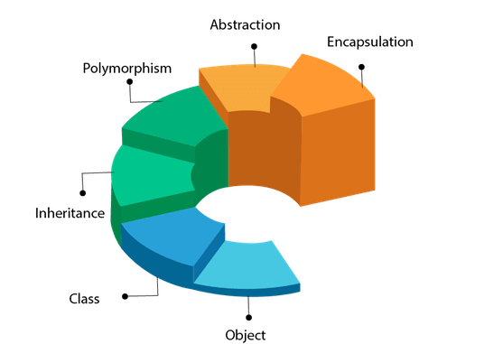

OOPS
Object Oriented Programming System
Object-Oriented Programming or OOPs refers to languages that uses objects in programming.
To bind together the data and the functions that operate on them so that no other part of the code can access this data except that function.
To implement real-world entities like inheritance, Abstraction, Encapsulation, polymorphism.

Slide 4

CLASS
A class is simply a logical description of a set of objects.
It is the blueprint/plan/template that describes the details of an object.
It refers to a logical entity. It does not consume memory at runtime. It is used for creating objects at run time.
It provides the data structure, provides initial values for the attributes, and methods that provide the logic for the intended behavior of the object.
E.g., a ‘Employee’ may be defined as a class.

Slide 5

OBJECT
An object represents an entity in the “real” world.
An object refers to the run time instance created from the class during program execution.
Every object has attributes or properties (contain information describe the state of objects) and methods (consists of things that the object knows how to do) to support the behavior.
Objects consume memory space when they are initialized.
E.g., Employee1, Employee2, etc. … are the
instance of a class ‘Employee’.

Slide 6
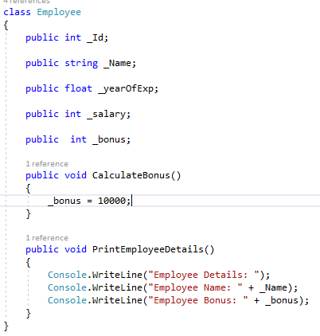

EMPLOYEE CLASS
What is the Object?

Slide 7
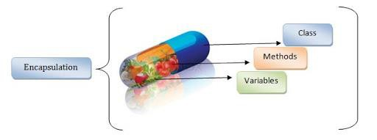
ENCAPSULATION
It allows the binding of the data and the logic together in a single entity. It also allows the hiding of data.
It allows data-hiding as the data specified in one class is hidden from other classes.
Hidden data can be restricted to the members of that class.
It provides a protective shield that prevents the data from
being accessed by the code outside this shield.
Levels are Public, Protected, Private, Internal, Protected Internal and Private Protected.
Declaring all the variables in the class as private and writing public properties in the class to set and get the values of variables.

Slide 8
ACCESSIBILITY LEVELS
public
Access is not restricted.
private
Access is limited to the containing class.
internal
Access is limited to the current
project.
protected
Access is limited to the containing class or classes derived from the containing class.
protected internal
Access is limited to the current project or classes derived from the containing class.
private protected
Access is limited to the containing class or classes derived from the containing class within the current project.

Slide 9


C# PROPERTIES
A property is a member that provides a flexible mechanism to read, write, or compute the value of a private field.
Can be used as if they are data members, but they are special methods called accessors.
Enable a class to expose a public way of getting and setting values, while hiding implementation.
A get property accessor is used to return the property value, and a set property accessor is used to assign
a new value.
Properties can be read-write, read-only or write-only.
The syntax for Defining Properties:
<access_modifier> <return_type> <property_name>
{
get { // body } set { // body }
}

Slide 10
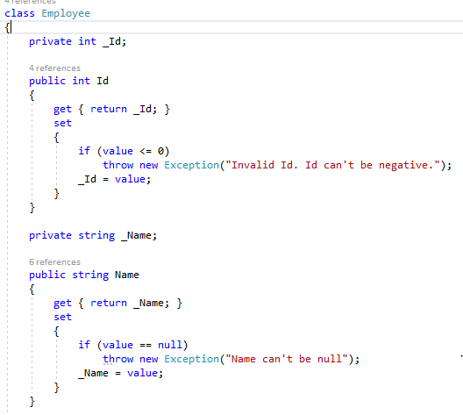


C# PROPERTIES IN EMPLOYEE CLASS
Without C# Properties With C# Properties
Accessing Fields/Properties in Main()

Slide 11
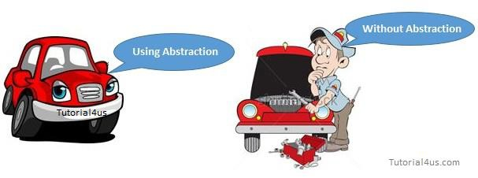
ABSTRACTION
It is the ability of object-oriented programming that allows hiding the implementation details of
logic yet allows for access to only important information.
It shows only the necessary details to the client of an object. i.e., it shows only required details for an object, not the inner constructors, of an object.
Ex: while riding a CAR, you know that if you raise the accelerator, the speed will increase, but you don’t
know how it happens.

Slide 12
INTERFACE
An interface is a collection of an abstract method.
It is a concept of OOPs that allows you to declare methods without defining them. Interfaces specify what a class must do and not how.
You cannot create objects from the interface. When a class implements an interface, it needs to implement the methods provided by the interface.
Interfaces can’t have private members.
By default, all the members of Interface are public and abstract.
Syntax for Interface Declaration:
interface <interface_name >
{
// declare methods and properties
}

Slide 13
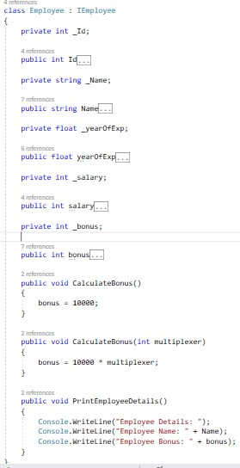
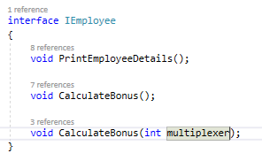
INTERFACE FOR EMPLOYEE CLASS
Interface Implementation
Interface
Creating & Accessing in Main()

Slide 14
ABSTRACT CLASS
An abstract class is a class which cannot be instantiated.
Creation of an object is not possible with an abstract class
An abstract class is made of both abstract and non-abstract methods.
The abstract methods are only declared, however, not implemented.
Abstract Class that contains some of the methods as abstract is known as an Abstract Base Class.
Abstract Class that contains all the methods as abstract is known as pure Abstract Base Class.
Syntax for Abstract Declaration:
abstract class <abstractClass_name >
{
// declare or define methods
}

Slide 15
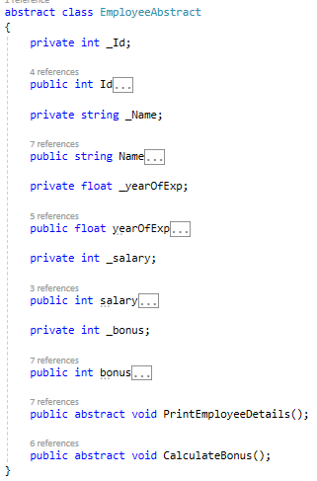
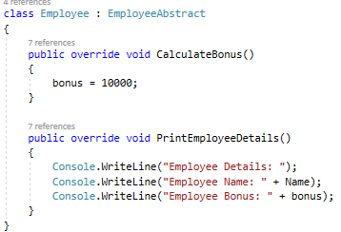

ABSTRACT CLASS FOR EMPLOYEE CLASS
Abstract Class Abstract Class Implementation
Creating & Accessing in Main()

Slide 16
ABSTRACT CLASS VS INTERFACE
Abstract Class
It can have implementations for some of its member(Methods).
Abstract class members can have access modifiers.
It can contain fields.
Interface
It can’t have implementation for any of
its members(Methods).
Interface members cannot have access modifiers.
It can’t contain fields.

Slide 17
ENCAPSULATION VS ABSTRACTION
Encapsulation is a method to hide the data in a single entity or unit along with a method to protect information from outside.
Encapsulation can be implemented using by access modifier i.e. private, protected and public.
In encapsulation, the data is hidden using methods of getters and setters.
Abstraction is the method of hiding the unwanted information.
Abstraction can be implemented using
abstract class and interfaces.
In abstraction, implementation complexities are hidden using abstract classes and interfaces.

Slide 18
INHERITANCE
It is a concept where one class shares the structure and behavior defined in another class.
It is the mechanism by which one class can inherit the features(fields and methods) of another class.
Some classes have some things in common. The common things can be promoted to a Parent Class (Base Class). The specific things can remain in the Child Class (Derived Class).
Inheritance supports the concept of “reusability”
Inheritance Syntax:
class derived-class : base-class {
// methods and fields . .
}

Slide 19
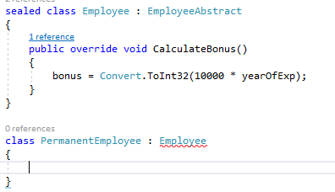
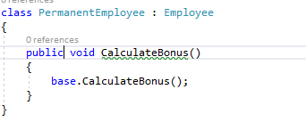
INHERITANCE
Sealed Class: Once a class is defined as a sealed class, this class cannot be inherited.
Abstract class can’t be declared as Sealed Class.
Base Keyword: The base keyword is used to access members of the base class from within a derived class
NOTE: An interface can inherit from another interface only and cannot inherit from an abstract class, whereas an abstract class can inherit from another abstract class or another interface.

Slide 20

INHERITANCE TYPE
Single Inheritance: When there is one base class and one derived class.
Multi-level Inheritance: When one class is derived from another derived class
Hierarchical Inheritance: When there are multiple classes derived from one base class Multiple Interface Inheritance: When one class is derived from multiple interfaces
NOTE: C# does not support multiple inheritances of classes.

Slide 21
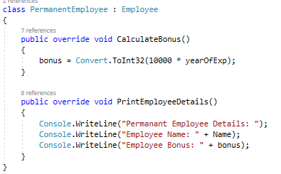
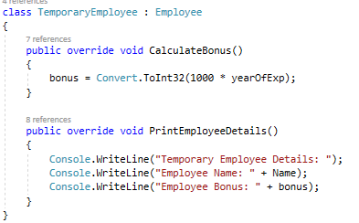
INHERITED CLASSES FROM EMPLOYEE CLASS
Permanent Employee Class
Temporary Employee Class

Slide 22
POLYMORPHISM
It means an ability to exist in multiple forms.
Polymorphism are of two types:
Compile-Time Polymorphism i.e. Method Overloading:
A single interface can be implemented in multiple ways by providing various definitions.
Run-Time Polymorphism i.e. Method Overriding
It is nothing but assigning behavior or value in a subclass to something that was already declared in the main class.

Slide 23
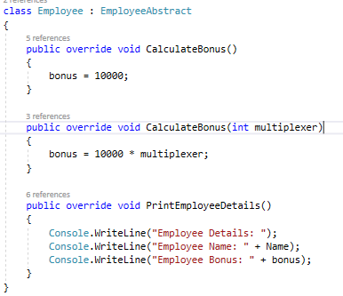
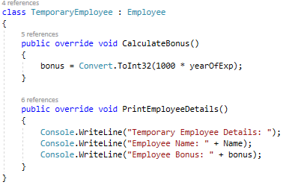
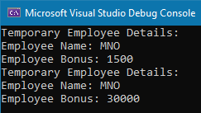
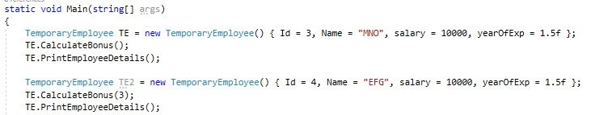
COMPILE-TIME POLYMORPHISM
Employee Class Temporary Employee Class
OUTPUT
Main()

Slide 24
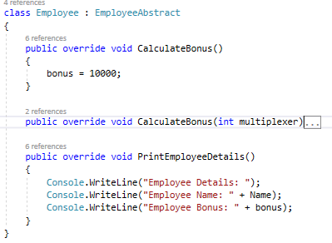
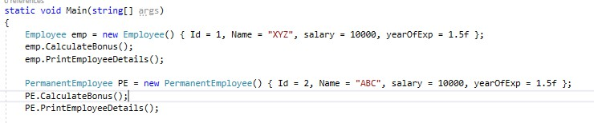
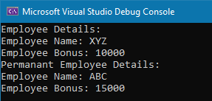
RUN-TIME POLYMORPHISM
Employee Class Permanent Employee Class
OUTPUT
Main()

Slide 25
SOLID - Single Responsibility Principle (SRP)
Definition:
A class should have only one reason to change.
Each class should have a single responsibility or purpose.
Benefits:
Improved maintainability and readability.
Easier to understand and extend.
Minimizes ripple effects when making changes.

Slide 26
SOLID - Open/Closed Principle (OCP)
Definition:
Software entities should be open for extension but closed for modification.
Encourages adding new functionality without altering existing code.
Benefits:
Promotes code stability.
Facilitates code reuse and extension.
Reduces the risk of introducing bugs in existing code.

Slide 27
SOLID - Liskov Substitution Principle (LSP)
Definition:
Objects of a superclass should be replaceable with objects of a subclass without affecting the correctness of the program.
Subtypes must be substitutable for their base types.
Benefits:
Enhances code reusability.
Prevents unexpected behavior when substituting objects.
Ensures consistency in behavior across the inheritance hierarchy.

Slide 28
SOLID - Interface Segregation Principle (ISP)
Definition:
A class should not be forced to implement interfaces it does not use.
Promotes the creation of specific, client-focused interfaces.
Benefits:
Improved maintainability and readability.
Reduces interface abuse.

Slide 29
SOLID - Dependency Inversion Principle (DIP)
Definition:
High-level modules should not depend on low-level modules. Both should depend on abstractions.
Abstractions should not depend on details; details should depend on abstractions.
Benefits:
Promotes decoupling, flexibility, and ease of testing.
Facilitates easier testing of components

Slide 30

QUESTIONS?
SOTI Confidential - Only for use under NDA - Do not distribute

Slide 31





THANK YOU
soti.net
© 2020, SOTI Inc. All Rights Reserved
SOTI Confidential - Only for use under NDA - Do not distribute

